Slide 1
19CS3113S
Analysis and Design of Algorithms
Session -30

Slide 2
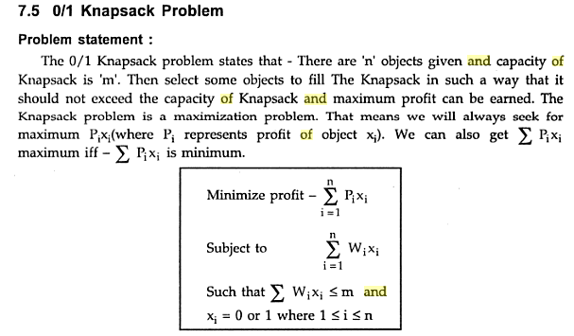

Slide 3
Example
Consider the knapsack instance: n = 4;
(pi, p2,p3, p4) = (10, 10, 12, 18);
(wi. w2, w 3, w4) = (2, 4, 6, 9) and M = 15.

Slide 4
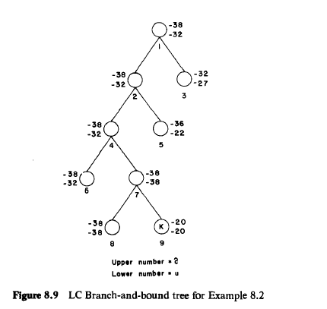

Slide 5
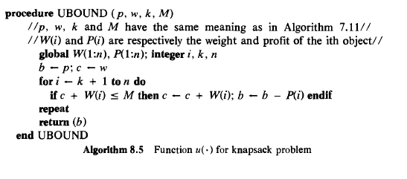

Slide 6
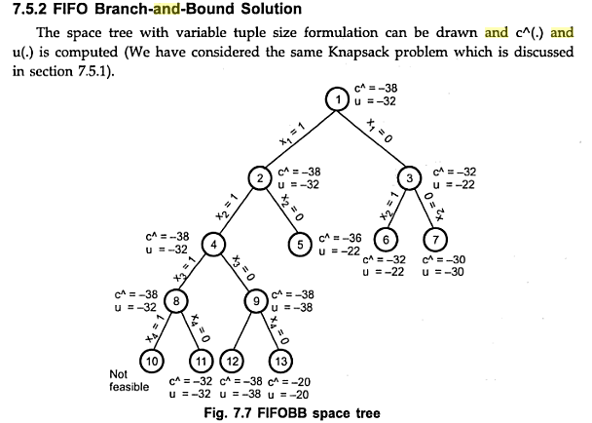

Slide 7
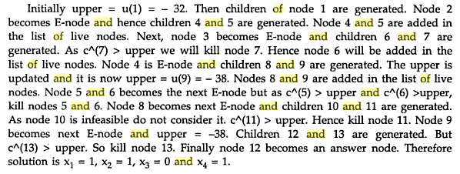

Slide 8
Thank you

